Slide 1
BANK CUSTOMER CHURN CLASSIFICATION MODELING
STEVENS INSTITUTE OF TECHNOLOGY, FALL 2019, CS – 513 B

Slide 2




PROJECT BY:
Vedadnya(Ved) Jadhav
10450603
Tushar Arvind Kamble
10444787
Bhakti Dalvi
10449007
Harishkumar M
10450618

Slide 3
AGENDA
Problem Statement
About Bank churn classification model
About Data
Project Flow
Data Preprocessing
Exploratory Data Analysis
Classification Models
Conclusion

Slide 4
PROBLEM STATEMENT
Bank customer churn is a major problem in most of the large banks
Since they cannot keep a track of the number of customers who exited the bank and the reason for which they left the bank
This would definitely help the bank in improving the methods and resolve the problems that customers might be facing and hence leaving the bank

Slide 5
ABOUT BANK CHURN CLASSIFICATION MODEL
This classification model, uses the various features which helps us to classify whether an existing customer will exit the bank or not
The model can be used in analysis of various business requirements like customer retention campaign, impact on revenues, customer relationship management
Banking systems can use this classification model to classify their new customers by the existing features or modify the same
This will intend help in Business development and retainment of customer by taking necessary steps for the flagged customers.

Slide 6
ABOUT DATA
Age: between 18-92
Tenure:less than one year to 10 years
CreditScore: This score should should be according to FICO standard, it's between 350-850
Geography: From which country that person is
Balance: 0 - ~250,000
NumOfProduct: Number of product, it's between 1-4
HasCrdCard: Some people have credit card, some don't
IsActiveMember: Whether an user is active or not
EstimatedSalary: it's between 90 ~200000
Exited: 1 - exited, 0 - Not-exited
The raw data is taken from: https://www.kaggle.com/barelydedicated/bank-customer-churn-modeling

Slide 7
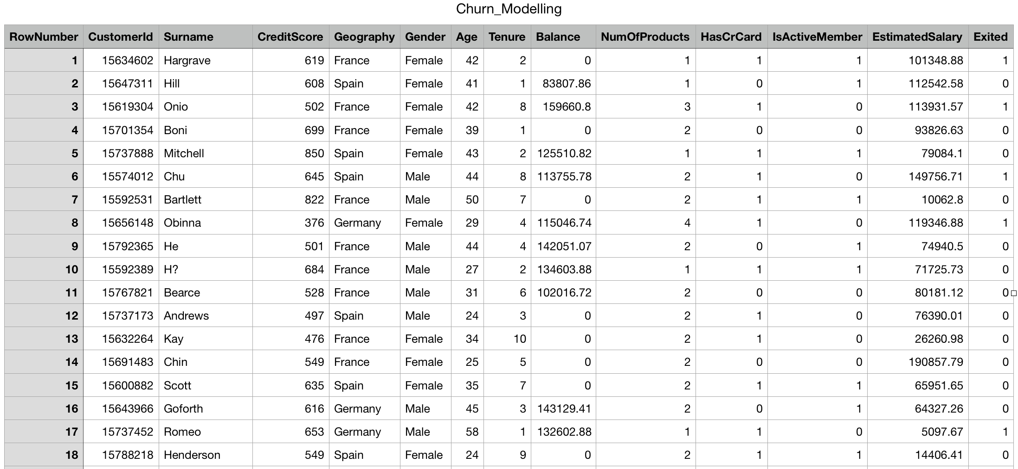
DATA SCREENSHOT

Slide 8
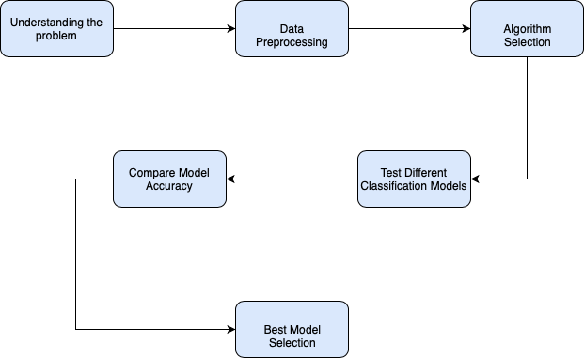
PROJECT FLOW

Slide 9
DATA PREPROCESSING
We changed the categorical values (gender, geographical location) into quantitative variables by using one hot encoding.
The Credit Score feature had a value from 350-850 which we divided into 5 bins 300-579 as 0, 580-669 as 1, 670-739 as 2, 740-799 as 3 and 800-850 as 4 and we got this bin category from FICO.
To not lose the specific data from the Credit Score feature we created another column using initial values of Credit Score and divided those with respect to Age and named the column as Credit Score given Age

Slide 10
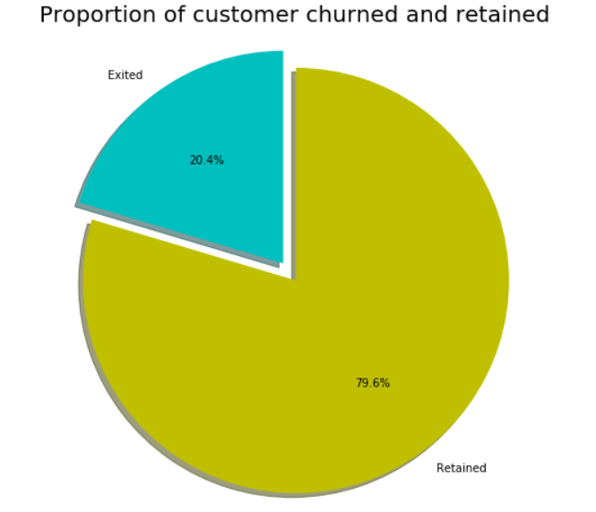
EXPLORATORY DATA ANALYSIS
The following graphs shows the distribution of customers who have exited and customers who haven’t
It shows that out of the 10,000 rows around
20.4% are customers who churned and
the rest retained

Slide 11
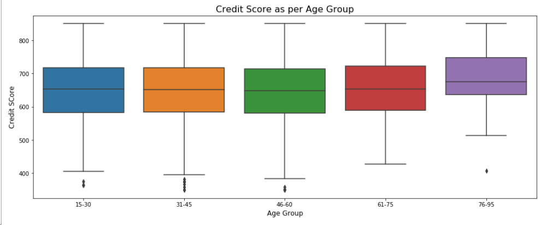
EXPLORATORY DATA ANALYSIS
The following box plot shows the Credit Scores distribution with respect to the age groups
As anticipated, the credit score of the higher end age groups of 61-75 and 76-95 is higher than the lower end age groups

Slide 12
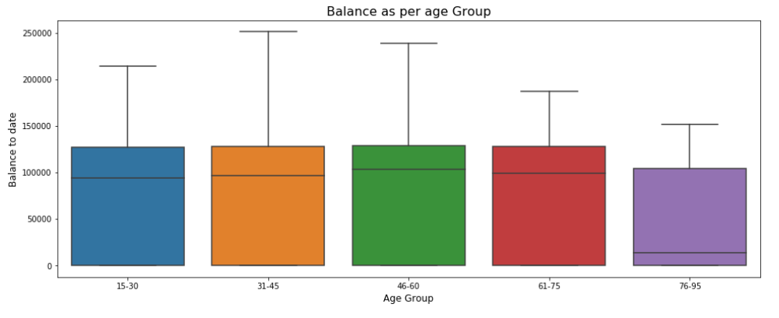
EXPLORATORY DATA ANALYSIS
The highest balances are observed in the middle age group of 31 to 60

Slide 13
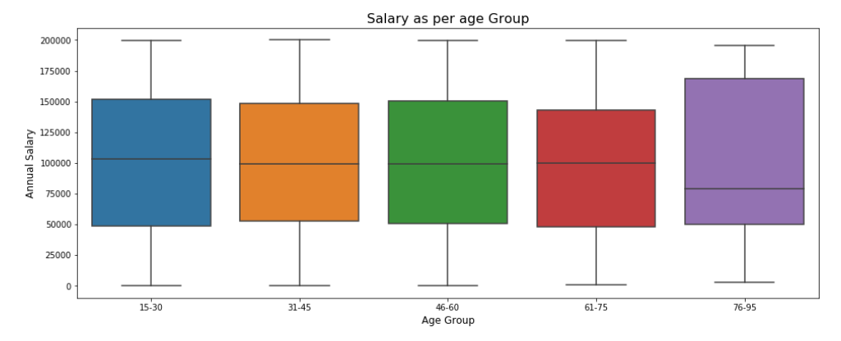
EXPLORATORY DATA ANALYSIS
Apart from the age group of 76-95, the annual salary observed in other age groups is fairly the same

Slide 14
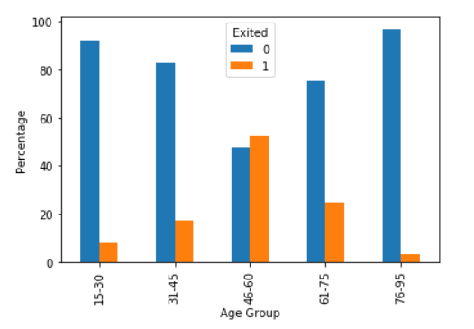
EXPLORATORY DATA ANALYSIS
The age group 46-60 has witnessed more number of churns followed by the age group 61-75.

Slide 15
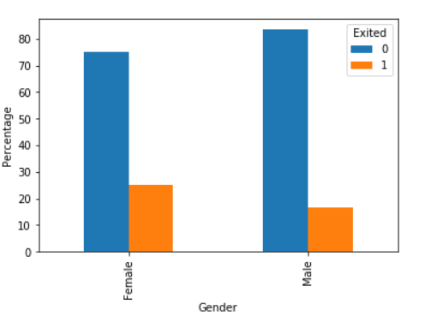
EXPLORATORY DATA ANALYSIS
The graph shows that the males have comparatively higher number of bank accounts than their counterparts and their exit rate is lower too

Slide 16
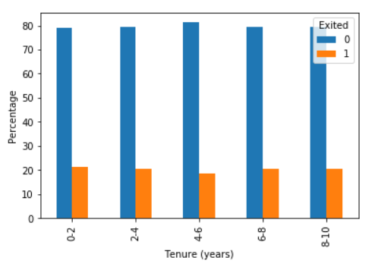
EXPLORATORY DATA ANALYSIS
The percentage of retention and exit is approximately same across all age groups

Slide 17
CLASSIFICATION MODELS:
K Nearest Neighbour
Decision Tree
Random Forest
Naive Bayes
Artificial Neural Network
Support Vector Machine

Slide 18
K NEAREST NEIGHBOUR
Unsupervised method - Where a target variable is specified – The algorithm “learns” from the examples by determining which values of the predictor variables are associated with different values of the target variable.
The principle behind nearest neighbor methods is to find a predefined number of training samples closest in distance to the new point, and predict the label from these.
for k=1 Accuracy : 0.7805
for k=5 Accuracy : 0.8095
for k=10 Accuracy : 0.812

Slide 19
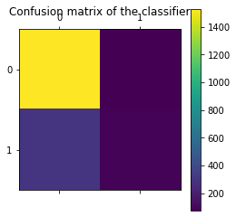
K NEAREST NEIGHBOUR
Accuracy : 0.812
precision recall f1-score support
0 0.86 0.97 0.91 7963
1 0.74 0.36 0.49 2037
accuracy 0.84 10000
macro avg 0.80 0.67 0.70 10000
weighted avg 0.83 0.84 0.82 10000

Slide 20
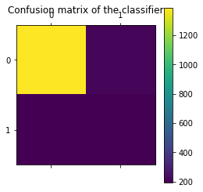
DECISION TREE
A Decision tree is a decision support tool that uses tree like models for decisions and their possible consequences, including event outcomes, resource costs and utility.
Accuracy : 0.7925
precision recall f1-score support
0 0.98 0.97 0.97 7963
1 0.89 0.90 0.90 2037
accuracy 0.96 10000
macro avg 0.93 0.94 0.94 10000
weighted avg 0.96 0.96 0.96 10000

Slide 21
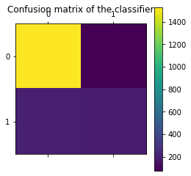
RANDOM FOREST
Random forest is a classifier that evolves from decision trees.
It actually consists of many decision trees
To classify a new instance, each decision tree provides a classification for input data; random forest collects the classifications and chooses the most voted prediction as the result
Accuracy : 0.86
precision recall f1-score support
0 0.97 0.99 0.98 7963
1 0.96 0.90 0.93 2037
accuracy 0.97 10000
macro avg 0.97 0.95 0.96 10000
weighted avg 0.97 0.97 0.97 10000

Slide 22

NAIVE BAYES
Naive Bayes classifiers are a collection of classification algorithms based on Bayes’ Theorem.
It is not a single algorithm but a family of algorithms where all of them share a common principle, i.e. every pair of features being classified is independent of each other and makes an equal impact on outcome.
Accuracy : 0.832
precision recall f1-score support
0 0.84 0.95 0.89 7963
1 0.62 0.31 0.41 2037
accuracy 0.82 10000
macro avg 0.73 0.63 0.65 10000
weighted avg 0.80 0.82 0.80 10000

Slide 23
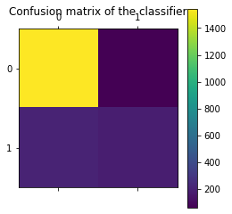
ARTIFICIAL NEURAL NETWORK
An Artificial Neural Network (ANN) is an information processing paradigm that is inspired by the brain
ANNs, like people, learn by example
An ANN is configured for a specific application, such as pattern recognition or data classification, through a learning process.
Accuracy : 0.865
precision recall f1-score support
0 0.88 0.97 0.92 7963
1 0.79 0.48 0.60 2037
accuracy 0.87 10000
macro avg 0.83 0.72 0.76 10000
weighted avg 0.86 0.87 0.85 10000

Slide 24
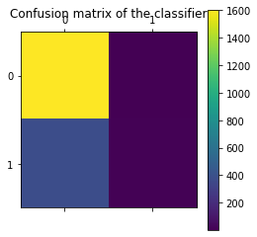
SUPPORT VECTOR MACHINE
The objective of the support vector machine algorithm is to find a hyperplane in an N-dimensional space(N — the number of features) that distinctly classifies the data points.
Accuracy : 0.8085
precision recall f1-score support
0 0.80 1.00 0.89 7963
1 0.87 0.03 0.06 2037
accuracy 0.80 10000
macro avg 0.83 0.51 0.47 10000
weighted avg 0.81 0.80 0.72 10000

Slide 25
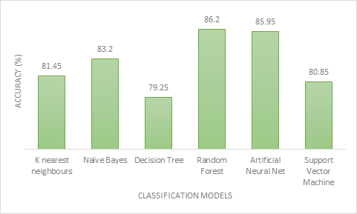
Conclusion
As per the classification models used and considering the accuracy of each and every model, the best classification model is Random Forest with 86% accuracy
The following graph compares the accuracy of the models used

